Slide 1
Create a Simple Proxy Interface
My training by tutorial from developers.sap.com
https://developers.sap.com/tutorials/aif-proxy-monitoring-interface-create..html

Slide 2
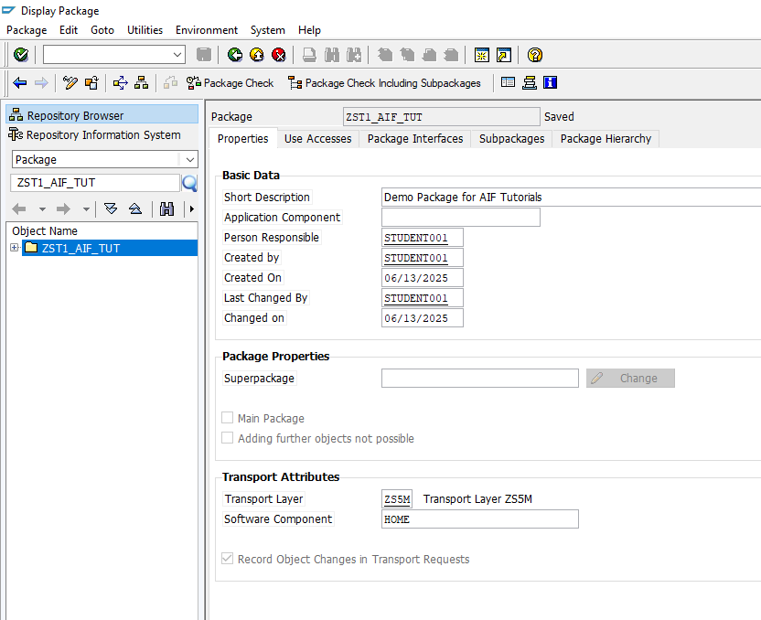
Create a package

Slide 3
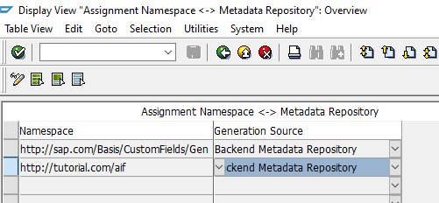
Next, you need to assign a new namespace to the Backend Metadata Repository.
Run transaction Assignment Namespace Generating Application (transaction code SPXNGENAPPL).
Switch to Edit mode, add a new entry, and enter or select the following details for your new namespace:
Save your changes.

Slide 4
CREATE PROXY
To create a new service interface, run the proxy editor (transaction code SPROXY_START).
In Enterprise Services: Initial Screen, select Create with Wizard and carry out the following configuration steps:
As Object Type, select Service Provider. Click Continue.
As Kind of Service Provider, select Backend. Click Continue.
As Name, enter and namespace http://tutorial.com/aif. Click Continue.
For the transport options, enter your package ZST1_AIF_TUT, select a workbench request, and enter the prefix ZAIF_. Select Continue.

Slide 5
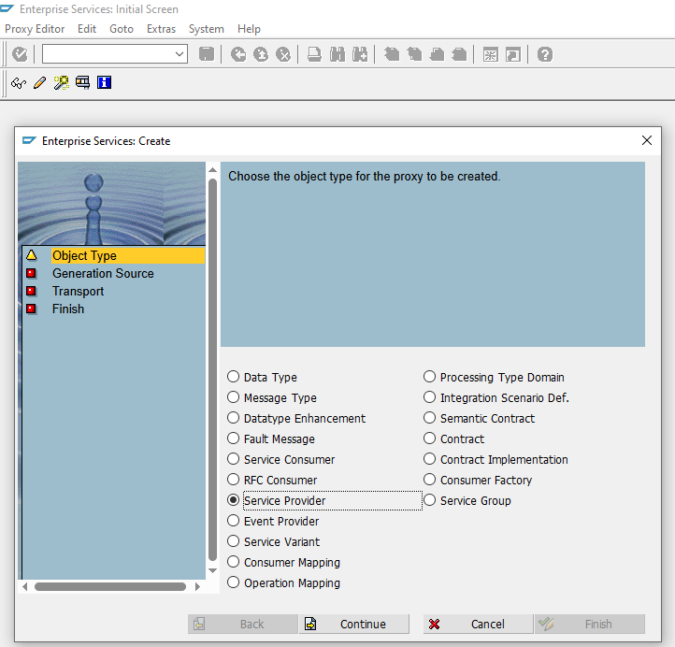

Slide 6
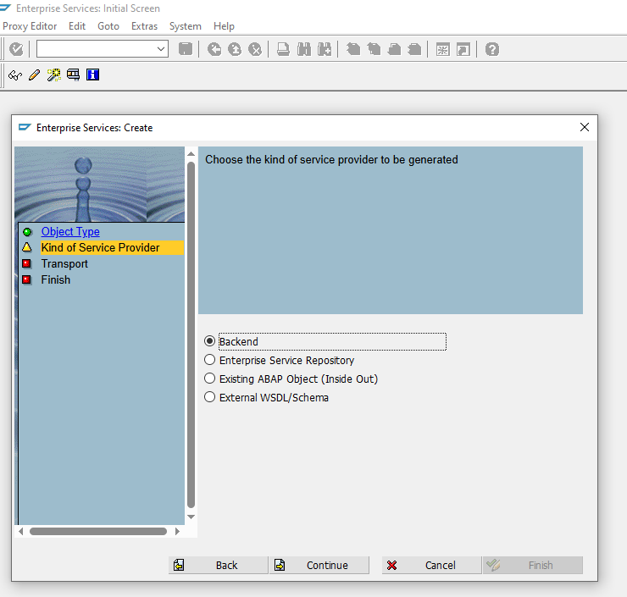

Slide 7
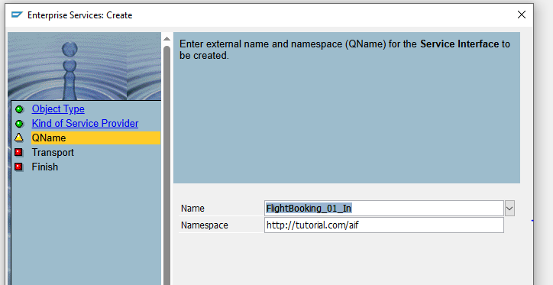

Slide 8
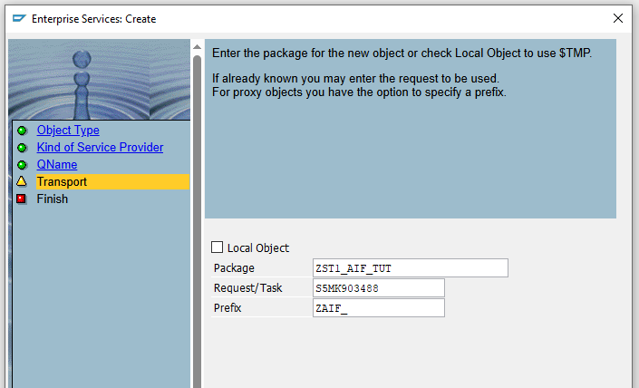

Slide 9
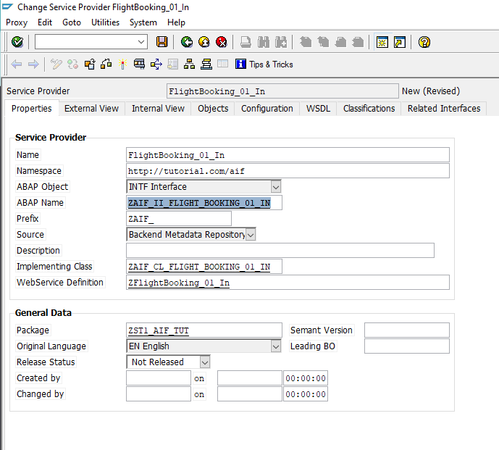

Slide 10
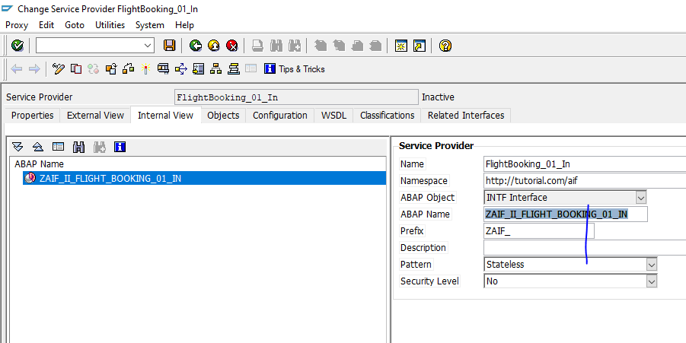

Slide 11
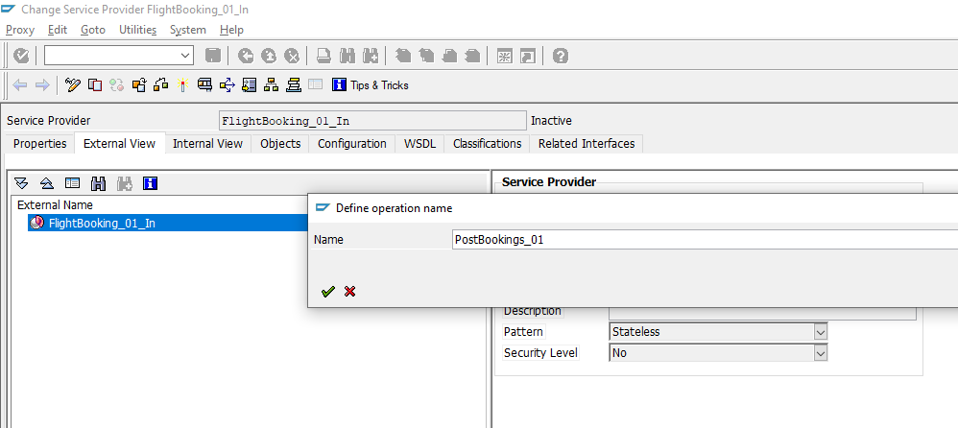

Slide 12
Next, you need to add an operation and a fault message type in the proxy editor.
Switch to the Internal View tab. Right-click your service provider and select Add Operation. Enter the operation name PostBookings_01. With the new operation selected, switch the Pattern of the operation to Not Reliable to simplify testing.
DEFINE PROXY STRUCTURES

Slide 13
Right-click the operation and select Set Request > Select Existing Message Type from the context menu.
In the upcoming Restrict Value Range dialog, remove all filters.
Enter the message type SXIDAL_FBO_REQUEST_MT in the ABAP Name search filter,
and the namespace http://sap.com/xi/XI/Demo/Airline in the Namespace search filter,
then press Enter. In the search result, select the found entry, and select Copy.
Right-click the operation and select Add Fault > Select Existing Fault Message Type.
Similar to the message type search, remove all filters. Then search for the fault message
type CX_SXIDAL_TECHNICAL_PROBLEMS.
Save and activate the proxy.

Slide 14
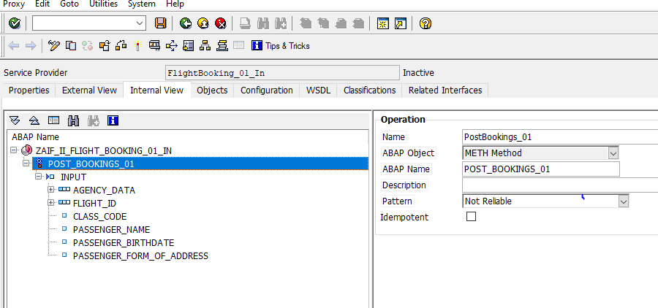

Slide 15
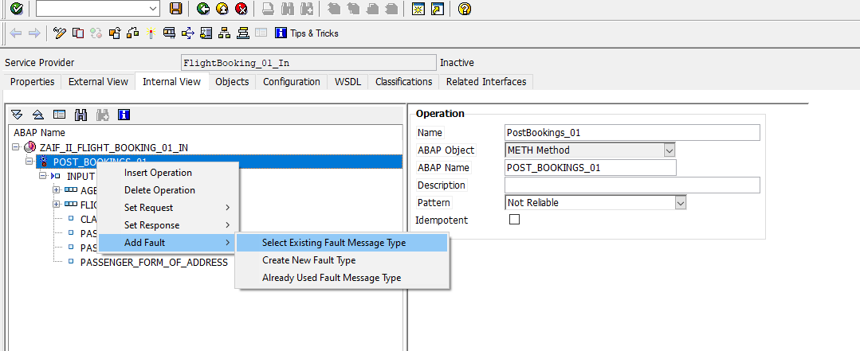

Slide 16
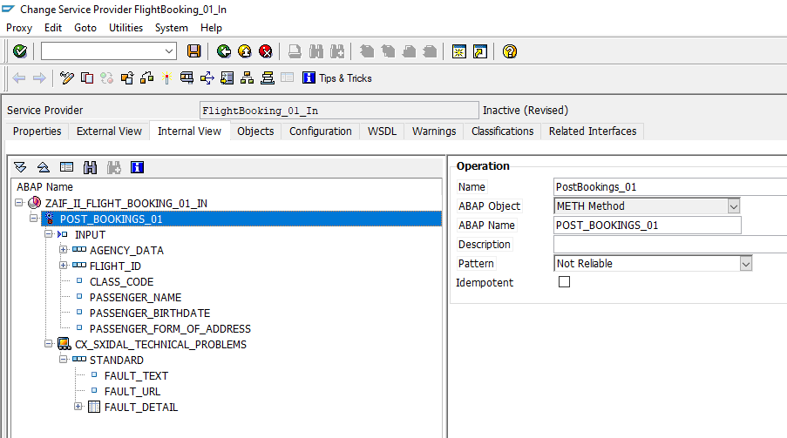

Slide 17
Implement proxy class method
Finally, to book the flights in your test scenario,
the proxy class method needs to be implemented.
Switch to the Properties tab.
Double-click the implementing class
ZAIF_CL_FLIGHT_BOOKING_01_IN
and then double-click the method
ZAIF_II_FLIGHT_BOOKING_01_IN~POST_BOOKINGS_01.
Maintain the implementation of the method by copying
and pasting the following:

Slide 18
